Slide 1
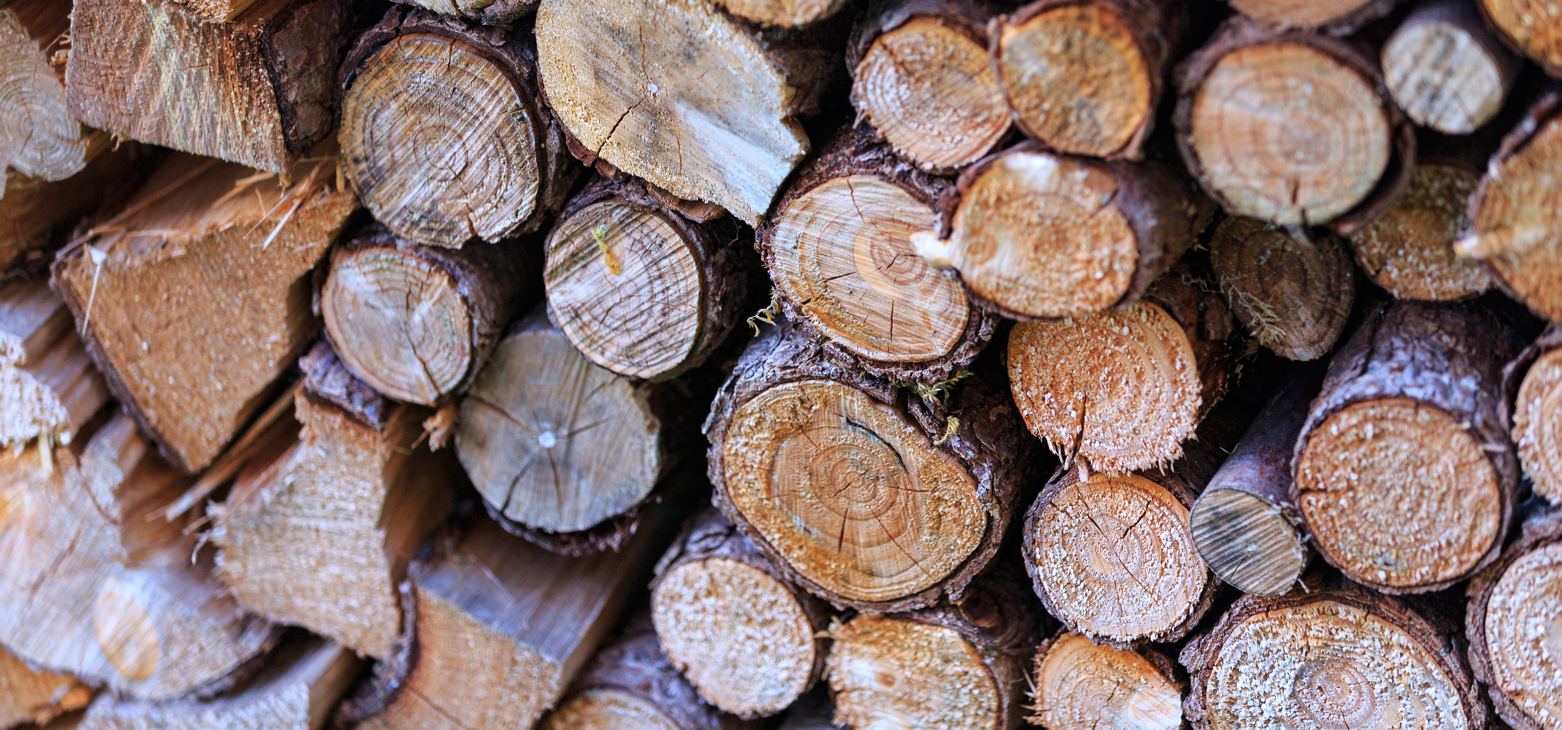
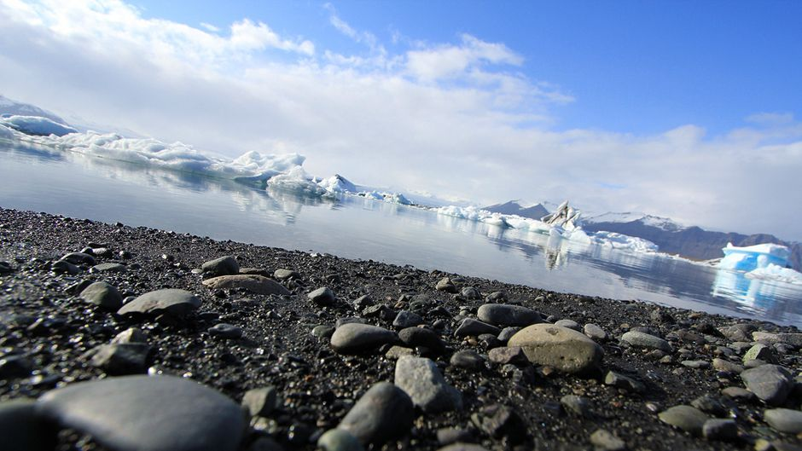
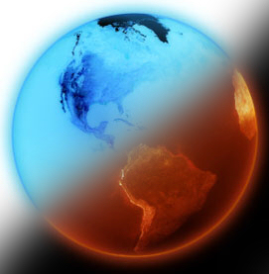
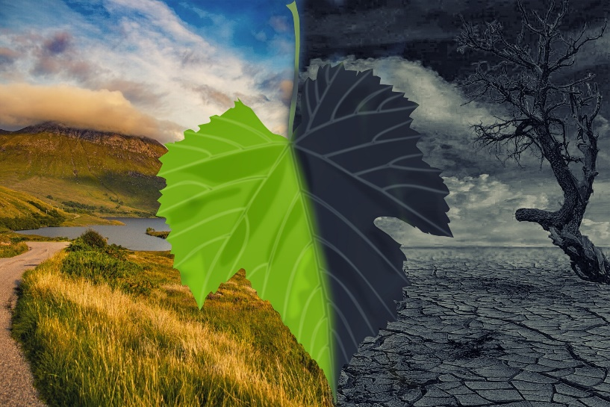
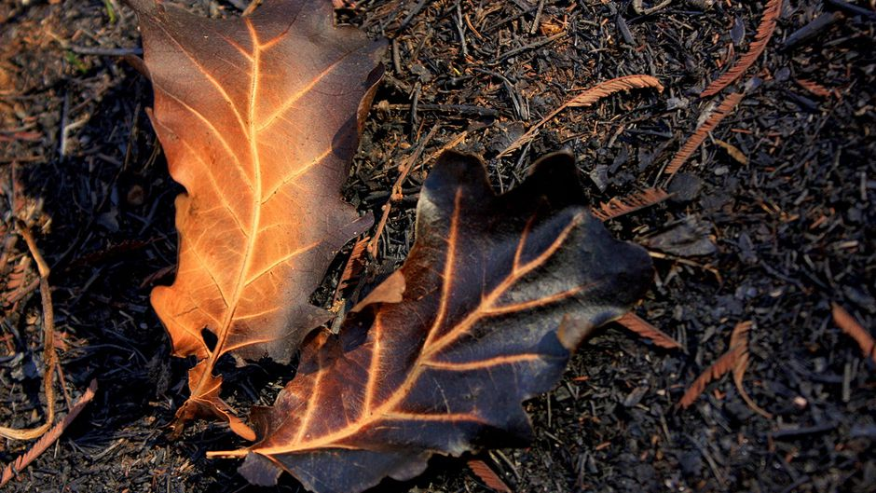
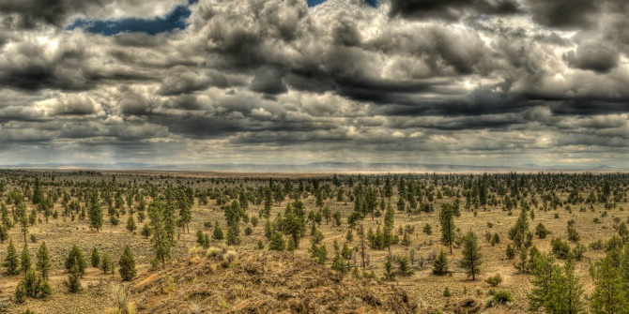
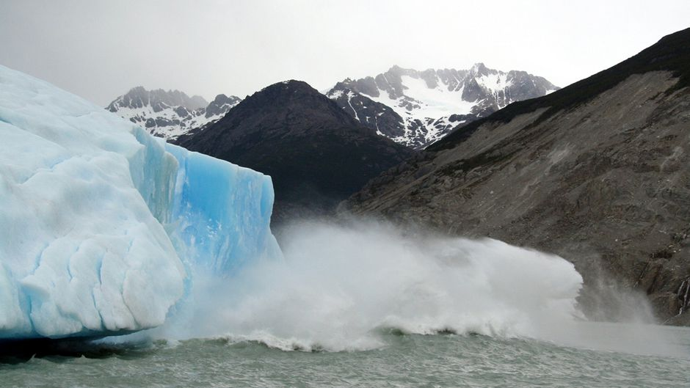
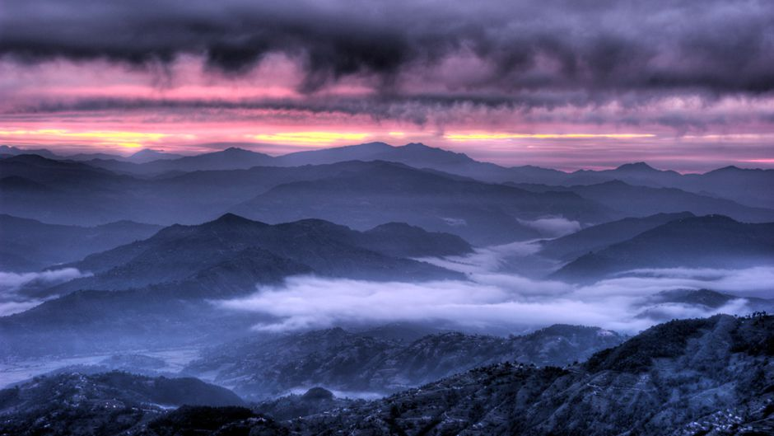
Change the
Story!

Slide 2
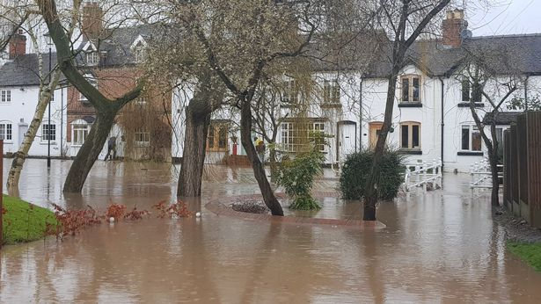
Flooding in Rolleston!
The problem is when it rains, it rains very heavily and it floods villages such as Rolleston. This effects peoples lives more than you know because it causes people to move house due to flooding. Also people have to pay for repairs.

Slide 3
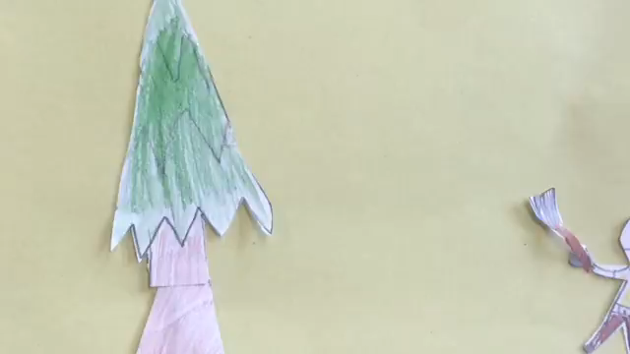
Climate change is caused by the actions shown in this video and more.

Slide 4
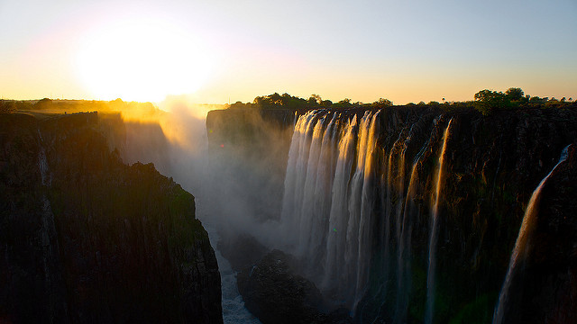
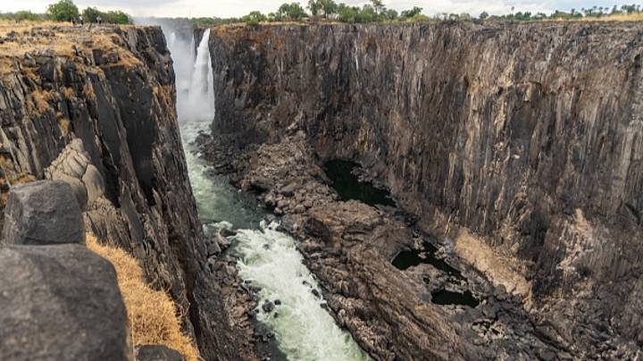
Sunset waterfall
Before
After
.
V

Slide 5

The consequences of climate change
We need to stop to save life on earth!
Stop now and we will all have a better life!!!!
If we carry on as we are climate change could get much worse!!!!!!
.
It could cause animal extinction or at best make animals endangered!!!!!
At worst climate change could destroy farms and cause starvation to humans
If we stop now humans will have a much better life in the future!!!!!!!

Slide 6
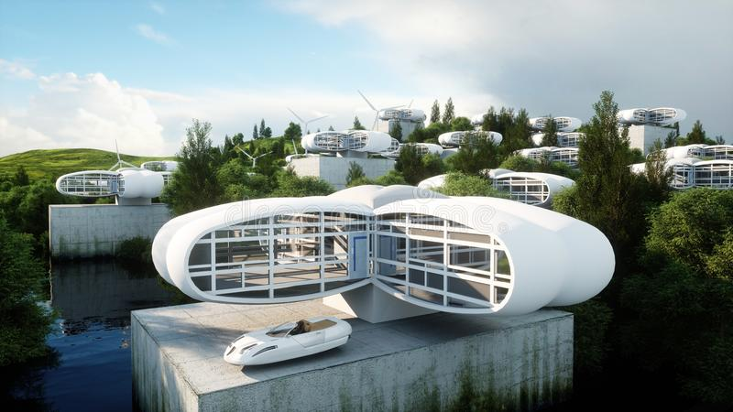
Towns villages in the future
If we do end up like this it will cause crop failure because of lack of farming. This will cause herbivores to starve.
In the future villages like Rolleston could become very modern and might be much larger and create less farming space which is a cause of climate change.

Slide 7
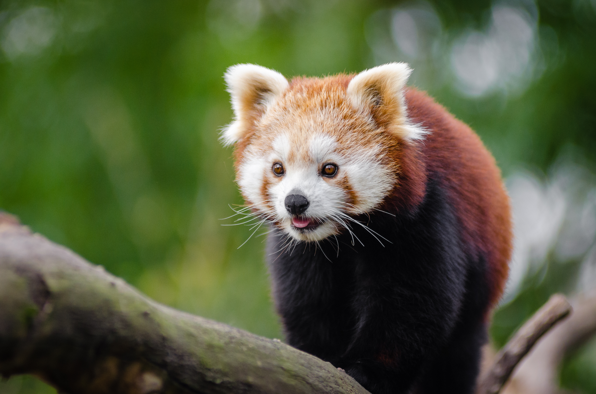
ENDANGERED ANIMALS
Unfortunately , due to climate change animals like Red pandas are becoming endangered. We all need to do our best to save the animals.

Slide 8
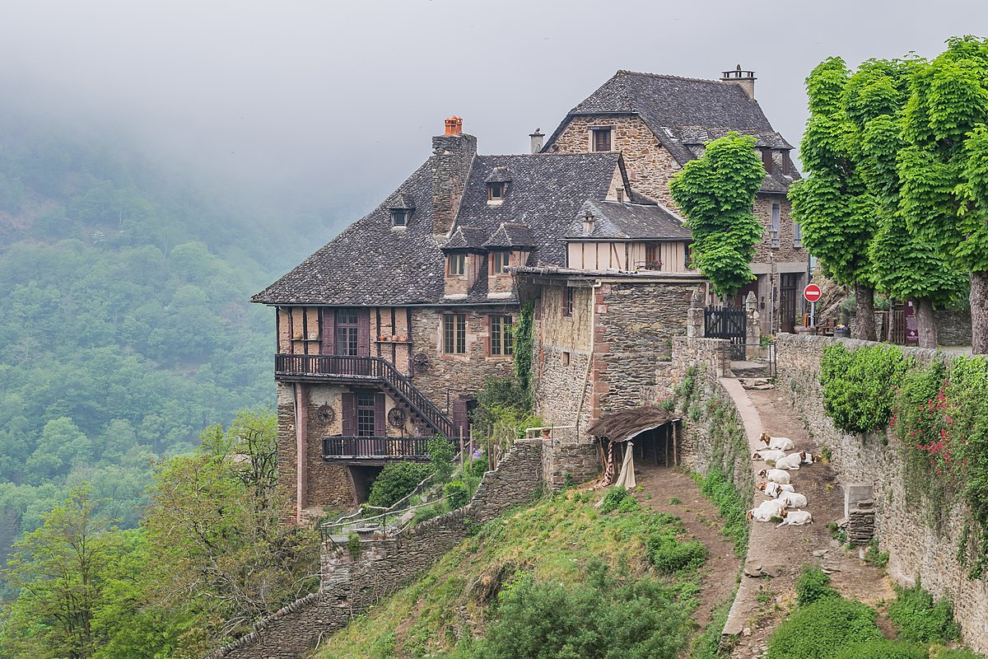
Our solutions
As you will already know from this power point climate change is caused by Co2(green house gas) and fossil fuels. We can stop this by not burning fossil fuels and not using our cars as much as we already do.
We can also stop it by checking we turn our lights off because it means people burn less fossil fuels. I hope this power point informed you about the causes of climate change and how YOU can stop it.
Help stop climate change

